Slide 1


College Social Hub
ECSE205L - Spring 2020
ANSHUMAAN PHUKAN-E19CSE062
RAVI SINGH-E19CSE270
RISHI MEHTA-E19CSE267
KUNDAN KUMAR-E19CSE078
MOHAMMAD OMAR FAROOQ-E19CSE090

Slide 2

Contents
Introduction
Problem
Solution
Software Requirements
Tech utilized

Slide 3


Slide 4

Introduction
In the time of online classes, we have noticed the lack of college atmosphere. It has become difficult to keep track events organized by different clubs and other student bodies. So we have decided to create a social hub for students by students. This is a hub where clubs can post their events, students can manage their personal schedules and interact with other students. Another thing we noticed is the lack of junior-senior interaction. This is a problem especially faced by 1st year students. Our platform aims to reduce this communication gap. So we have decided to create a website which is going to be created using HTML, CSS and JavaScript. We are also going to provide cloud storage for students to store and share their files. This website is going to provide a social hub to recreate the college atmosphere in virtual form.

Slide 5

Microsoft Azure, commonly referred to as Azure is a cloud computing service created by Microsoft for building, testing, deploying, and managing applications and services through Microsoft-managed data centers. It provides software as a service (SaaS), platform as a service (PaaS) and infrastructure as a service (IaaS) and supports many different programming languages, tools, and frameworks, including both Microsoft-specific and third-party software and systems.

Slide 6


Slide 7
Problem
Now a days we have seen many colleges/universities moving towards virtual learning platforms, taking tests from home, etc. But it would be difficult for users to easily understand the new environment.
Can the university afford to build its own on premises servers and maintain it throughout its lifetime?
will the bandwidth allow many students to take part in LMS based activities?
Will the software give remainders for upcoming activities and events??
Can this Software unsure network security and data privacy?

Slide 8


Slide 9

Solution
With the help of cloud computing services like Azure, we can pretty much solve all the problems stated before.
With the help of custom UI creator tools we can make a user friendly software solution.
By using cloud computing we don’t have to worry about the costs because we would be only paying for resources we require which makes this solution more flexible.
We don’t have to deal with managing storage servers, compute resources and networking as cloud computing services can deal with the hardware in the local datacentre.

Slide 10

Tech/resources utilized

Slide 11


Tech/Resources utilized <(datasets, H/W, tools etc.)>
HTML5
CSS3
JavaScript
Different Azure services related to virtual machines and storage.

Slide 12
Stakeholders
Stakeholder | Role
Anurag Goswami | Mentor
Rahul Kumar Verma | Mentor
Rishi | Team Member
Ravi Singh | Team member
Kundan Kumar | Team member
Mohammad Omar Farooq | Team member
Anshuman Phukan | Team member

Slide 13
Users
Admin
Student
Teacher

Slide 14
User stories Sprint 1
ID | Description | % Completed
1 | As a Admin I want to manage the data So that user can use it effectively | 100
2 | As a Admin i want to give security of teacher and students so that i can make my career | 100

Slide 15
User stories Sprint 2
ID | Description | % Completed
1 | As a student I want to be able to register online, So that I can register quickly and make use of the app. | 100
2 | As a student i want to give exam so that i can make my career | 100
3 | As a Student i want to upload files so that i can keep it safely in one place | 100
4 | As a Student i want to download files so that i can make use of it | 100

Slide 16
User stories Sprint 3
ID | Description | % Completed
1 | As a Teccher i want to see the activity of students so that i can manage the activity of students | 100
2 | As a teacher i want to take exam so that students can give exam | 100
3 | As a teacher i want to upload download and share files on the wesite so that students can have acess to it. | 100

Slide 17
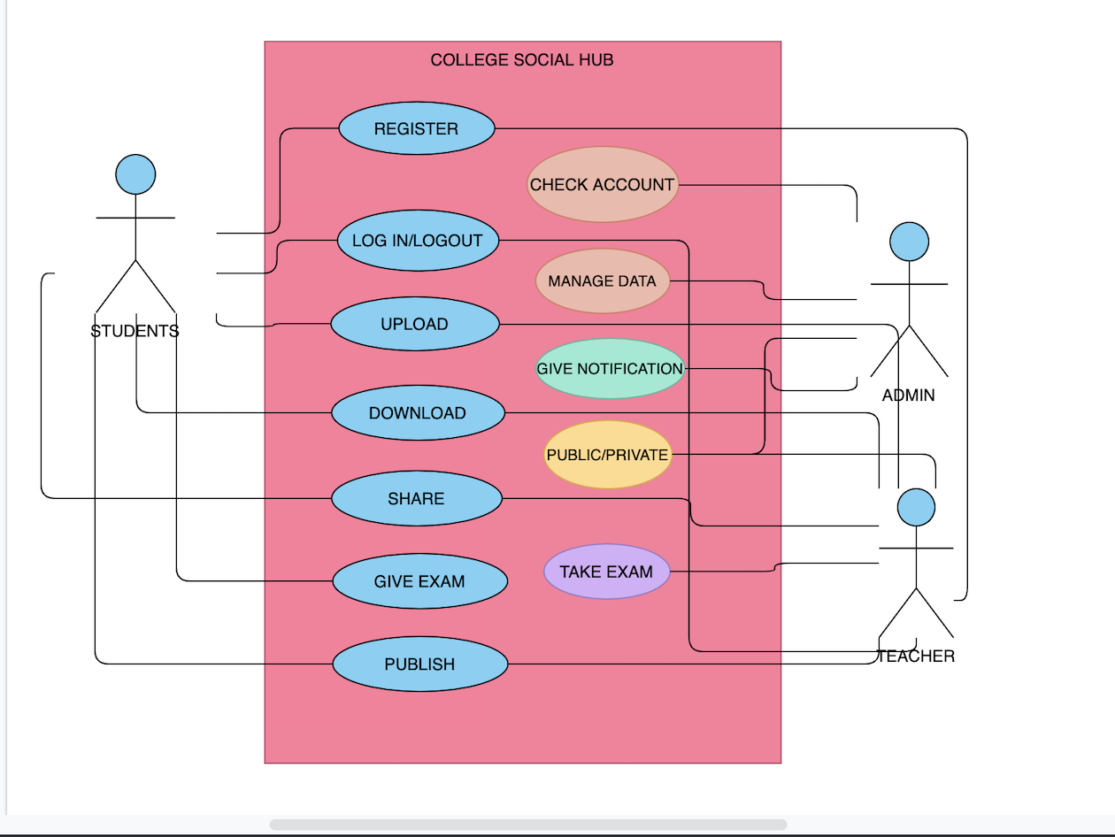
Use Case Diagram

Slide 18
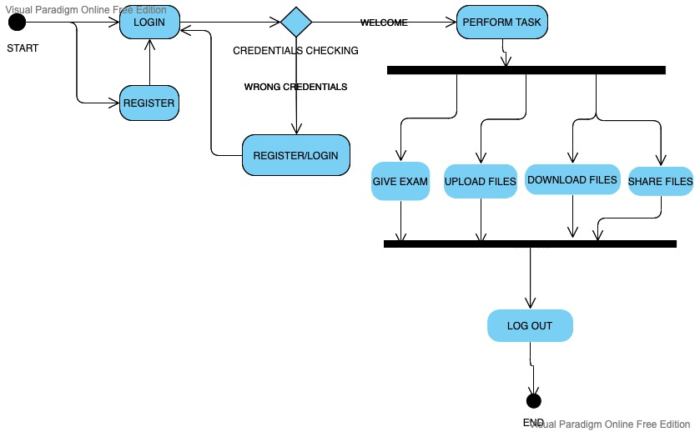
Activity Diagram

Slide 19
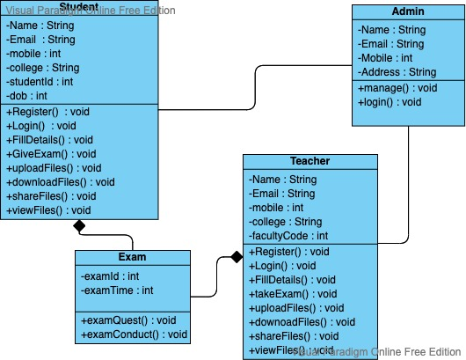
Class Diagram

Slide 20

Thank You

